Slide 1

Group 2
Final presentation: Tennis
Jordan Goedbloed | Arman Torabi | Golbert Ceita Pagês
Jesse de Zeeuw | Viggo van der Ven

Slide 2
Table of Contents
The business value
Dataset
Preprocessing
KNN
Benefits and Downsides
Training
XGBoost
Benefits and Downsides
Training
Results
KNN
XGBoost
Per player comparisons
Conculsion
Recommendations

Slide 3
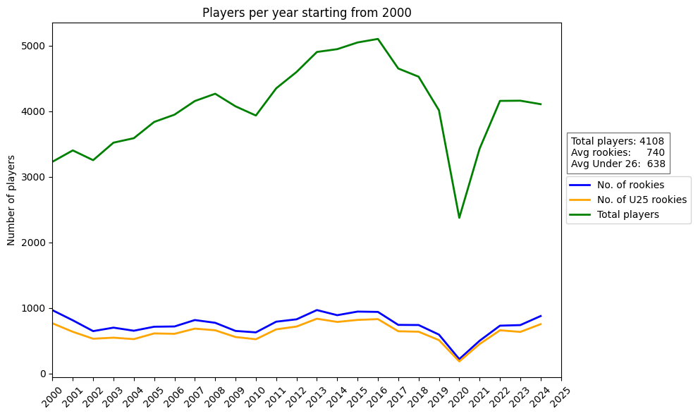
The business value
Predicting the peak ELO of a player; how good will a player be in the future.
Notes:
Imagine you’re a scout for a tennis club who is looking for promising young players. According to our data 743 new players start playing tennis at the ATP level per year of which 631 are under 26. It is difficult to analyse all these players at the same time. Especially when you need to allocate resources to the most promising ones so they can reach their potential.
Therefore, our research question is can we predict the peak elo of a player. This is especially useful for young players but can also be used by older players to decide if they want to continue playing even after they’ve reached their peak.

Slide 4
Dataset
Notes:
What features were present (that we also used) - Make sure to mention the match statistics and lack of them in the lower tier matches; forcing us to use scores. - Explain our rolling average features and why we chose them (captures recent form/performance better) - Explain out ELO rating and why it's better than ATP rank (ATP rank updates lag by a week while our rating system does it instantly) ATP rank also does not look further back than a year and is based on the rank points.

Slide 5
KNN
Notes:
Briefly explain how it works, benefits and downsides.

Slide 6
KNN
Notes:
Features

Slide 7
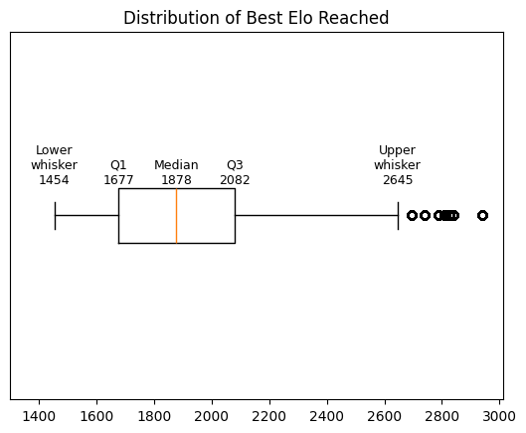
KNN
Six bins created by iteratively splitting on the median value to create a hierarchy
Bin Ranges | Percentage of players
0 – 1878 | 50%
1878 – 2082 | 25%
2082 – 2245 | 12.5%
2245 – 2355 | 6.2%
2355 – 2454 | 3.1%
2454+ | 3.2%
Notes:
Then explain how we binned the data (show boxplot)

Slide 8
KNN
K-value was chosen using GridSearchCV library
Feed sample of train data into CV pipeline
Get K-values, weight and distance metric
Plot K value on graph
Notes:
how the K-value was chosen

Slide 9
KNN
Splitting on player id
Splitting on days of experience & player id
Train set is 80% of players
Test set is 20% of payers
Train and test with full careers
Train set is all careers up to a cut off point plus 50% of the data after the cut off point
Test set is all data after the cut off point
All stats frozen except days and age; you don’t know how good a player will play in the future
Test only with latter part of career
Can isolate specific players
Notes:
Then explain the training scenarios.

Slide 10
XGBoost
Notes:
Briefly explain how it works, benefits and downsides.

Slide 11
XGBoost
Notes:
Features used

Slide 12
XGBoost
Notes:
Then explain how it was trained

Slide 13
XGBoost
Notes:
What hyperparameters were used

Slide 14
Validation
Notes:
KNN High level overview
Include confusion matrix, balanced accuracy for both sitations

Slide 15
Validation
Notes:
XGBoost high level overview

Slide 16
Comparison player 1
Notes:
Compare player 1 between KNN and XGBoost for 3,5,10 years

Slide 17
Comparison player 2
Notes:
Compare player 2 between KNN and XGBoost for 3,5,10 years

Slide 18
Comparison player 3
Notes:
Compare player 3 between KNN and XGBoost for 3,5,10 years

Slide 19
Conclusion
Notes:
Mention that XGBoost was better due to higher performance for R2 compared to the balanced accuracy of the KNN models.

Slide 20
Recommendations
Notes:
Mention how the data and features do not seem to have much of a relationship when plotting them vs the target. especially when using bins. This is probably due to noise. Mention the survivorship bias from training on more data (better players play longer). Mention the unbalanced nature of the bins for the KNN model, how it was tested with 6 equal bins which yielded one or two percent better accuracy, but that choosing 6 bins in this instance would be vibes based.

